Slide 1

Your Vote, Your Voice
Your vote is your power …
Click, Cast and Change the game.
Shape the future with just a tap !!
Get Started ->

Slide 2
Home
VOTER
Enter Email ID
Password
LOGIN
OR
ADMIN
Enter Unique ID
Password
LOGIN

Slide 3
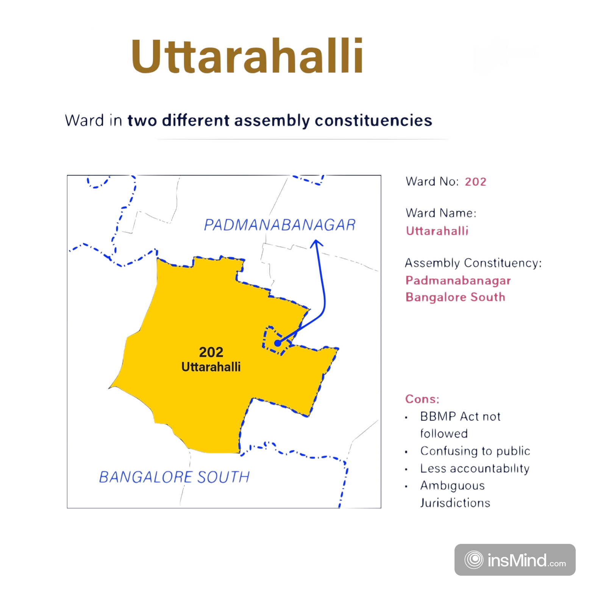
Constituency
Uttarahalli is an assembly constituency in the Bengaluru South region, specifically part of Bangalore Urban. As of the 2024 data, Bengaluru Urban, which includes Uttarahalli, has a significant voter base contributing to the overall numbers in the state of Karnataka. Uttarahalli falls within BBMP (Bruhat Bengaluru Mahanagara Palike) Zone Bommanahalli.
Next ->

Slide 4

Logout
WELCOME
Navaneeth N
Voter ID : YER5678104
Name :
Email ID :
Date of Birth :
Phone Number :
Address :
I, agree to the Terms & Conditions
Next ->

Slide 5
Logout
Voter ID : YER5678104
VOTE

Slide 6
Home
VOTER
Enter Email ID
Password
LOGIN
OR
ADMIN
Enter Unique ID
Password
LOGIN

Slide 7
WELCOME
ADMIN
Admin Key : 567810456
Name :
Email ID :
Date of Birth :
Phone Number :
Address :
Next ->

Slide 8
Logout
Home
ELECTION
CONTROL
VALIDATION
STATISTICS
VOTES

Slide 9
Logout
Home
Schedule an election
Unique ID :
Password :
Date :
Start Time :
End Time :
Schedule

Slide 10
Logout
Home
ELECTION
CONTROL
VALIDATION
STATISTICS
VOTES

Slide 11
Logout
Home
Instructions & Guidelines
To check validity of the blockchain, please click the below button.
Blockchain verification might take some time depending on the size of the chain. Please be patient while the process completes.
Double-check that the system is not being accessed from an insecure network or device during validation.
If the blockchain is invalid, the system will restore a backup, and the voting process may require revalidation from some users.
Once the process is complete, you will be notified of the result.
Validate

Slide 12
Logout
Home
ELECTION
CONTROL
VALIDATION
STATISTICS
VOTES

Slide 13
Logout
Home
Voting Percentages

Slide 14
Logout
Home
ELECTION
CONTROL
VALIDATION
STATISTICS
VOTES

Slide 15
Logout
Home
ID | Candidate ID | Timestamp

Slide 16
After Election is over Get started should take us to result page

Slide 17
Your Vote, Your Voice
Your vote is your power …
Click, Cast and Change the game.
Shape the future with just a tap !!
Get Started ->

Slide 18
RESULTS
Search Constituency
Uttarahalli
Winner:
Party:
Votes:

